Slide 1

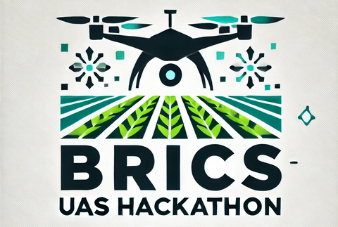

Crop Assessment
By: Brandon Goldhawk

Slide 2
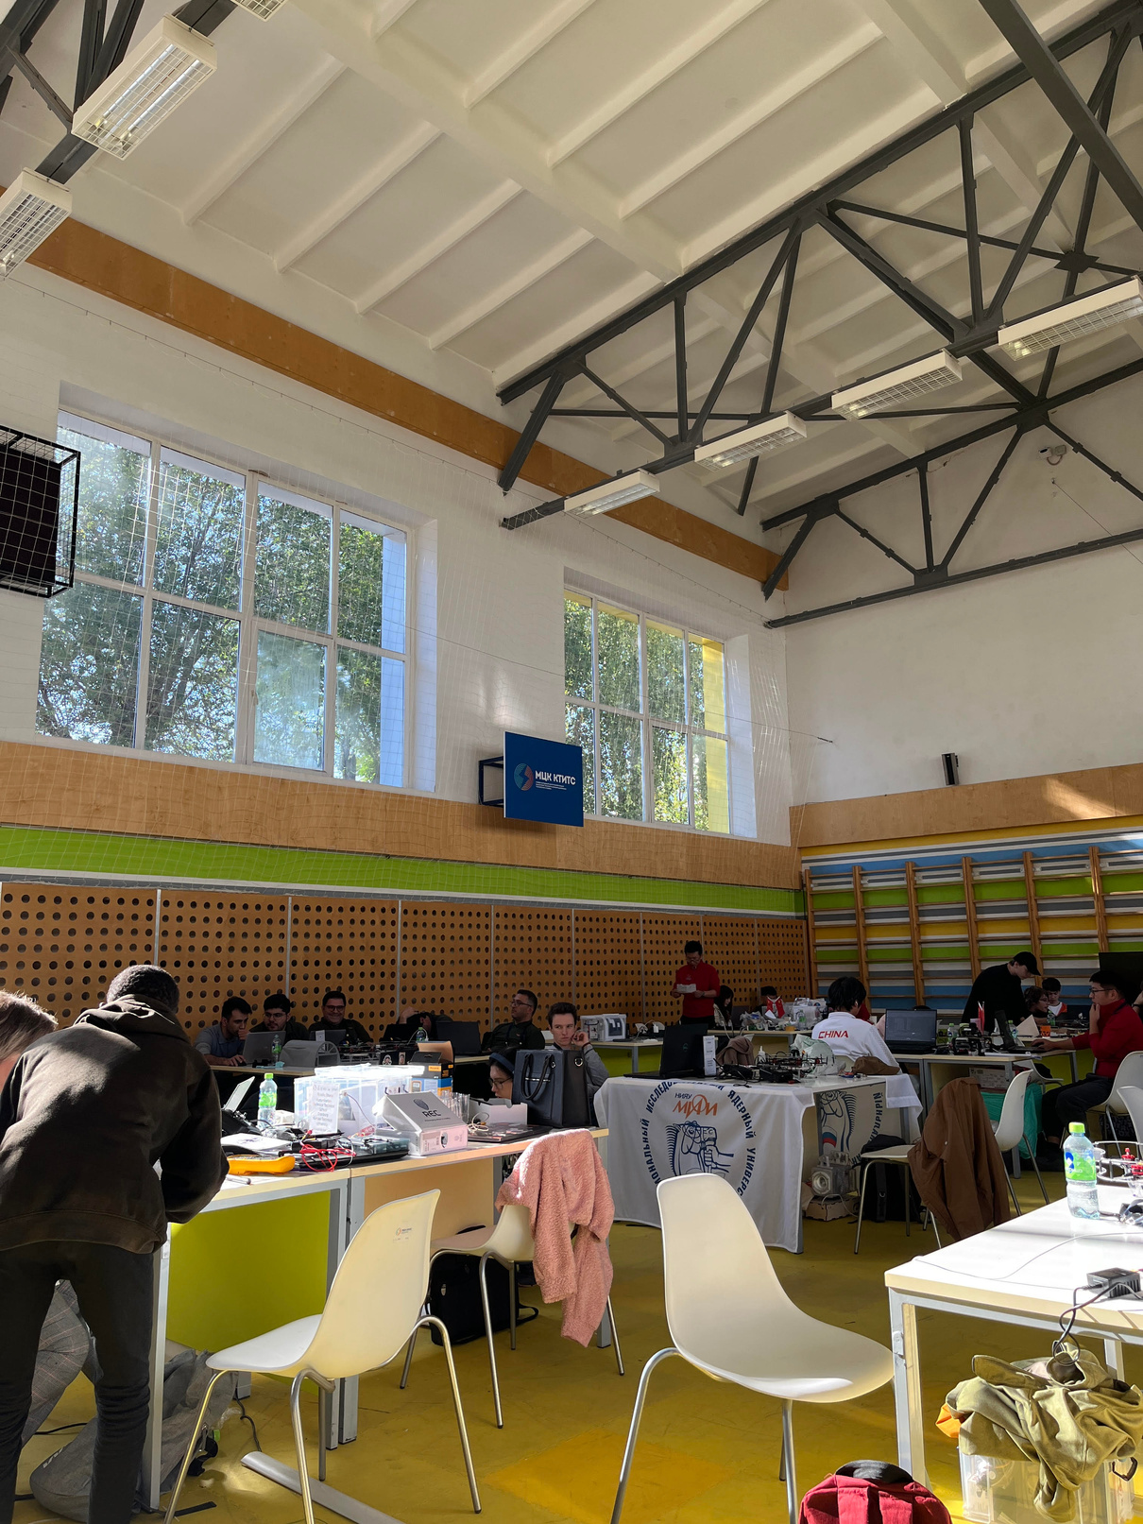

Overview
Introduction
About
Target Market & Analysis
How it works
Future Expansions

Slide 3
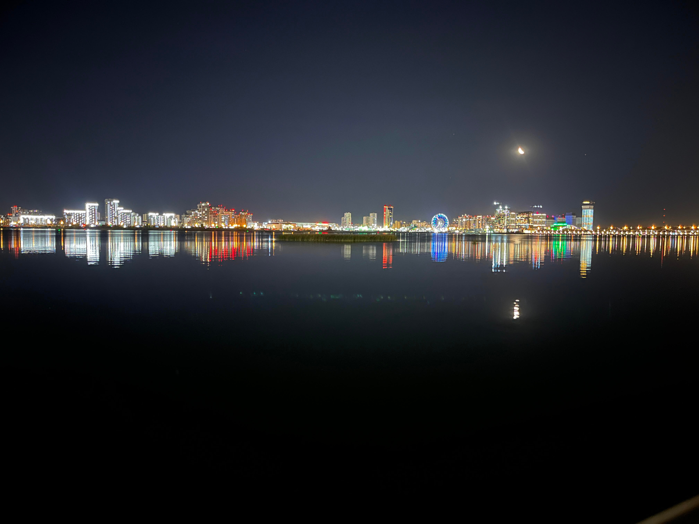
Introduction
Food security is a global issue, and as such every effort needs to be made to better food supply and distribution.
The use of drones in this sector is sought after as it can help alleviate the problems.

Slide 4
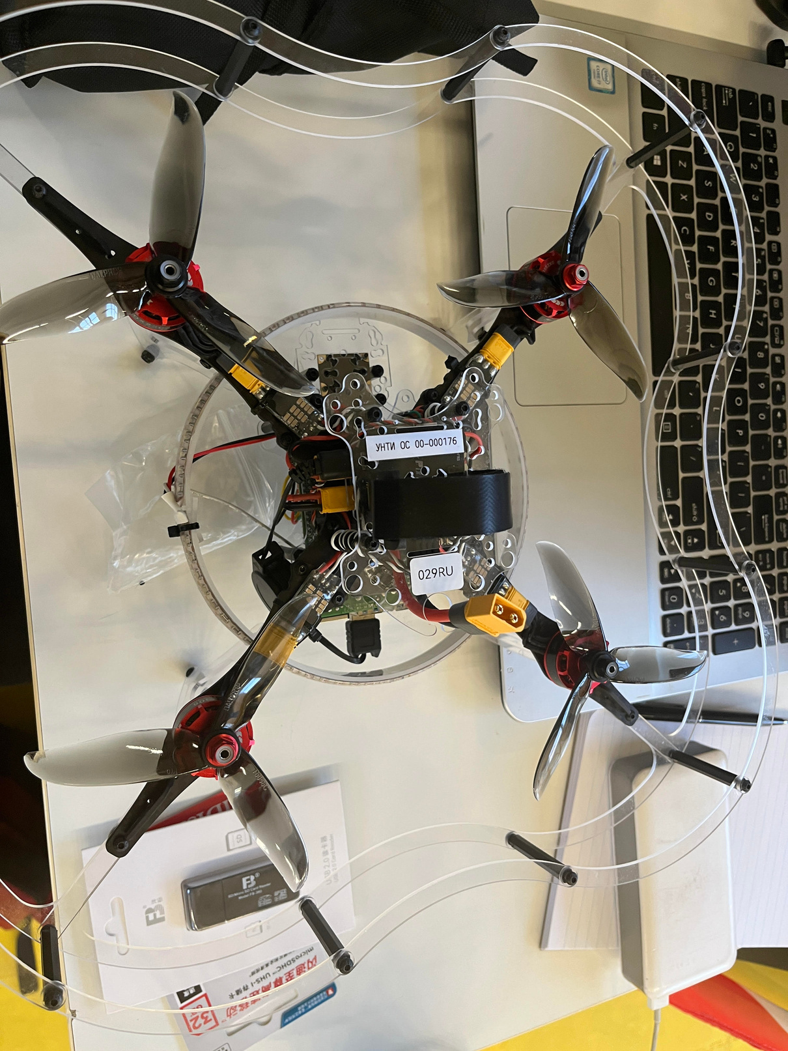
About the Project
Take photos of crops
Using Machine Learning analyse the image
Report back to say if the crop is healthy or not
Real time analysis
Inexpensive and time efficient to run
Large market
Reduces cost for the farmer

Slide 5
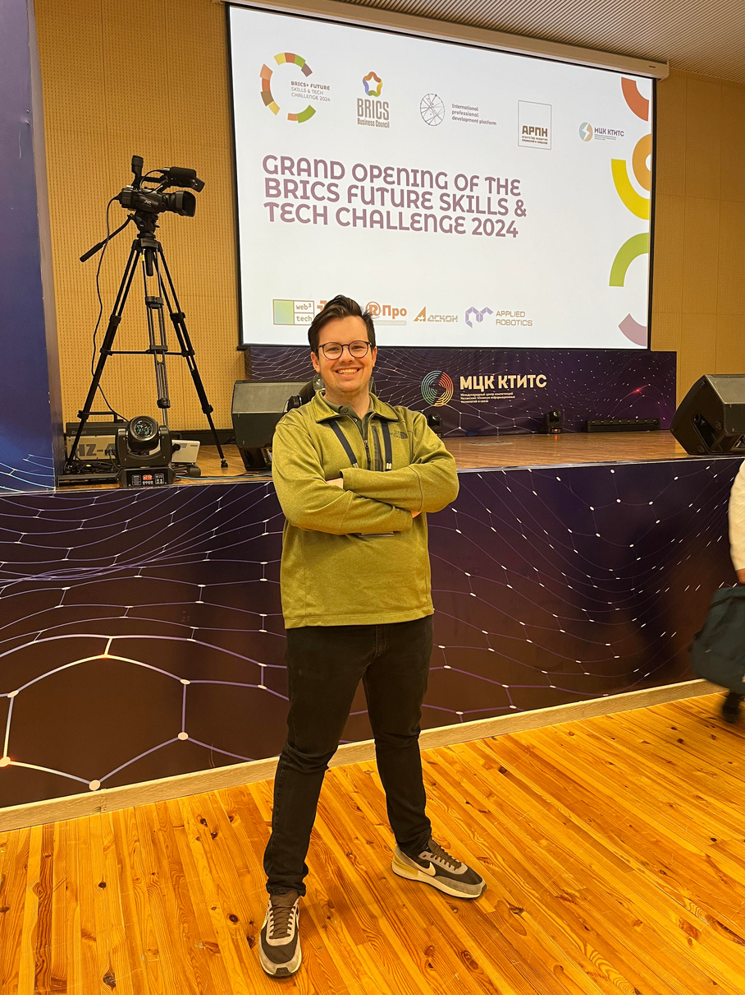
About Myself
From South Africa
3rd year student at Belgium Campus
Studying a Bachelor of Computing
Completed a BSc Human Genetics, Microbiology and Pharmacology from the University of Pretoria
Brandon Goldhawk

Slide 6
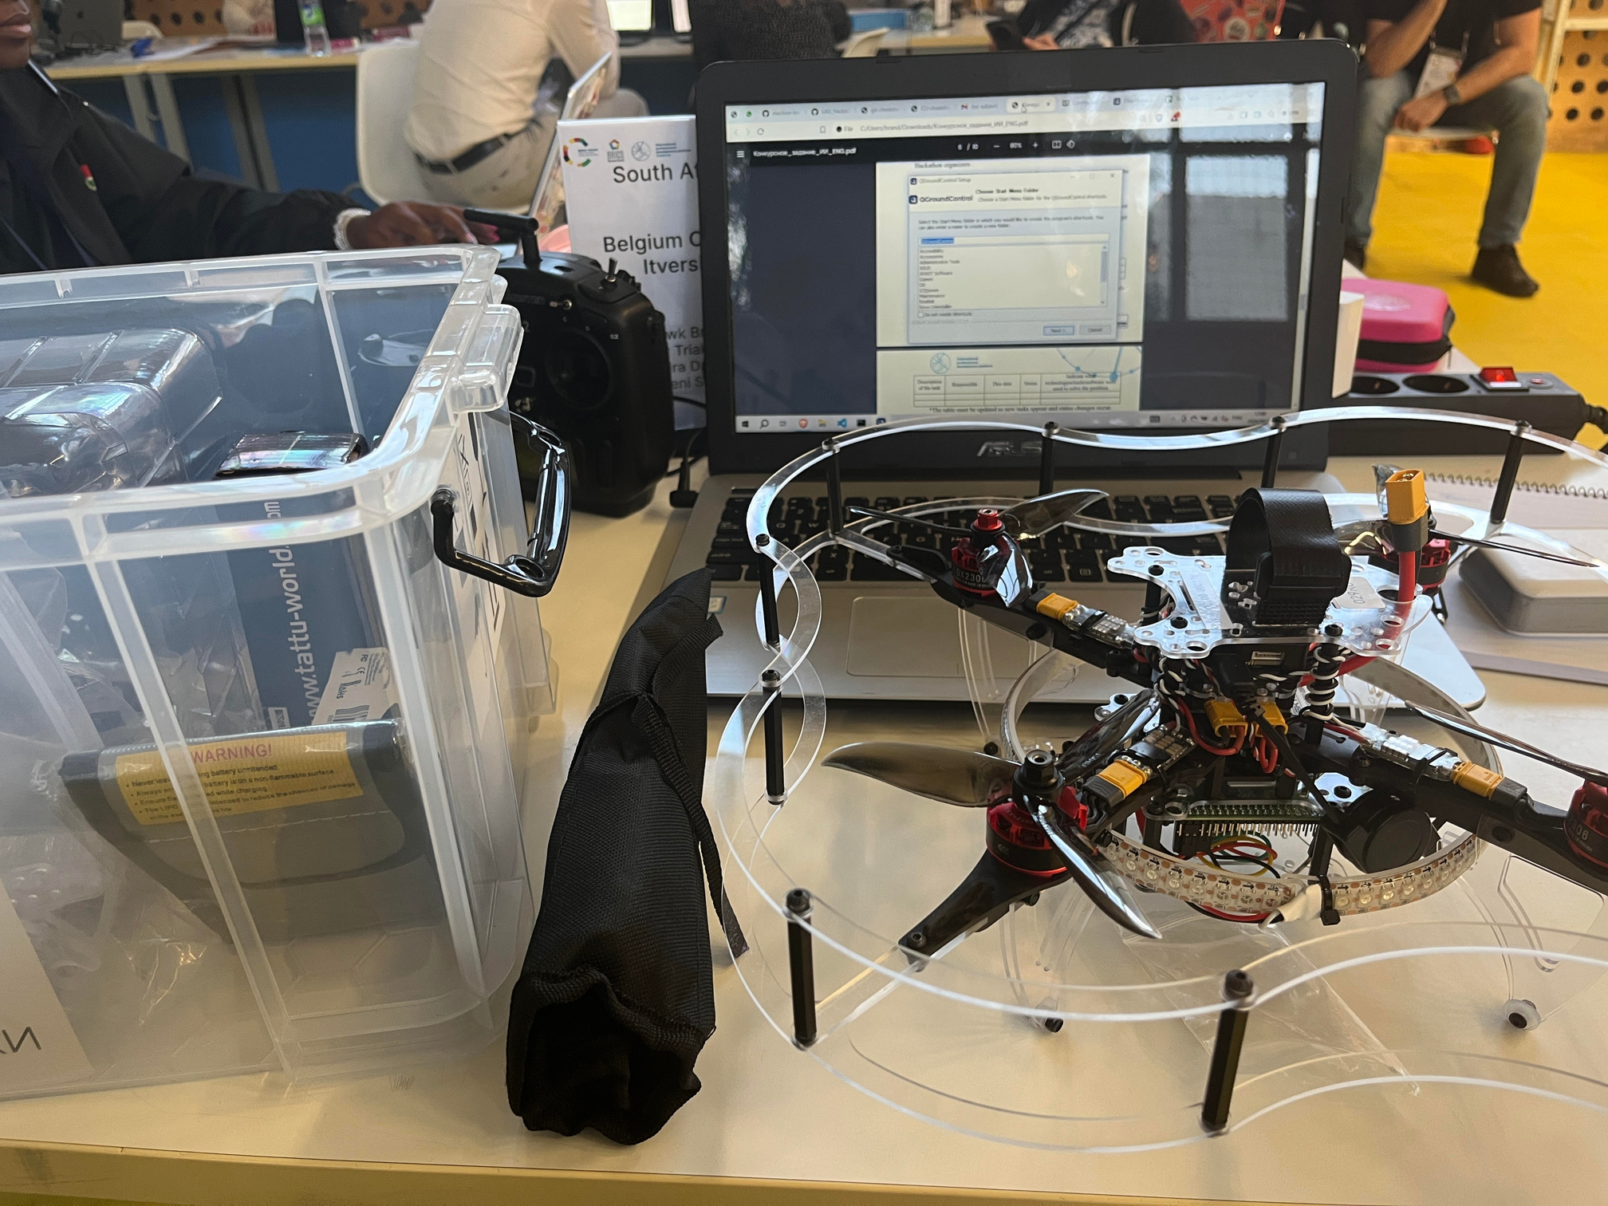
Target Market
Private Farmers
Corporate Farmers
Entrepreneurs
Corporates which own a large amount of land are able to bring in a number of drones
A lack of existing companies in the industry. You can buy-in cheap and a make a business from it
Able to bring in the product to conduct a survey and analysis of their farm

Slide 7
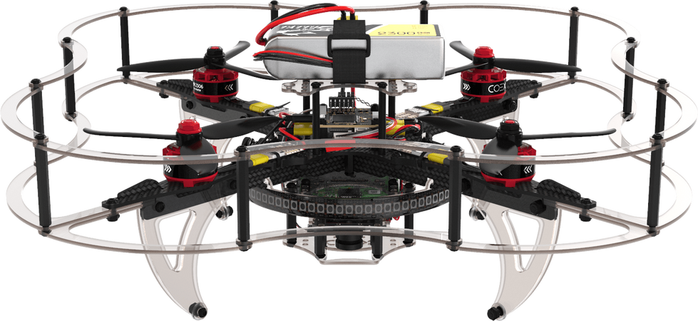
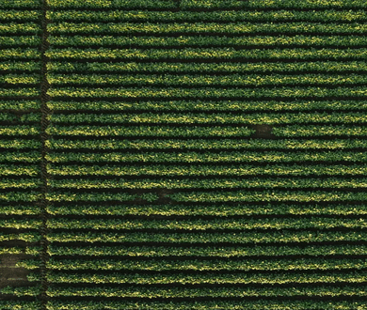
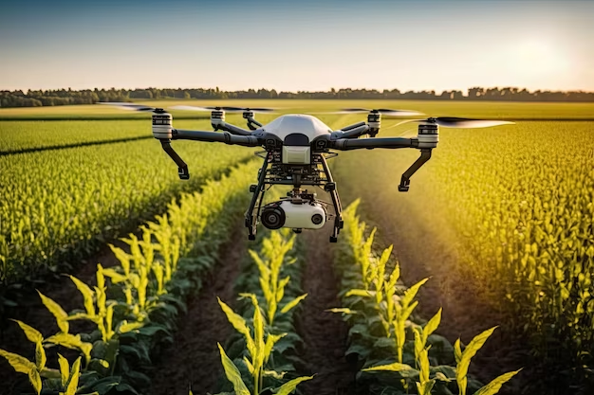
Market Analysis
Drones
Agriculture
Drones in Agriculture
Current market value - 22.4 Billion USD
Predicted growth of 12.2% p.a. to 62.32 Billion USD in 2032
Current market value - 334 Billion USD
Predicted growth of 9% p.a. to 667 Billion USD in 2029
Current market value - 4.3 Billion USD
Predicted growth of between 13-15% to a max of 11 Billion USD

Slide 8
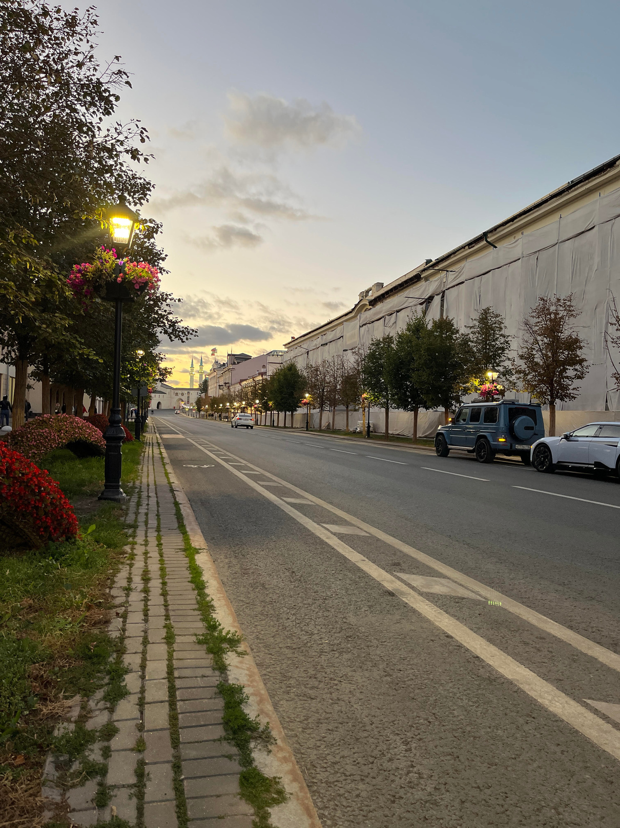



How it Works
Drone
Computer
Outcome
Specify how many photos and intervals between the photos
Fly the drone over the crops and take photos
Images sent in real time to the users computer and stored
Machine Learning model analysis pictures
The results (Healthy or Unhealthy) of the model are then sent to the user
The user can then make an informed decision

Slide 9

The Code
We are importing the following libraries:
OS
tensorflow
numpy
cv2
matplotlib.pyplot
time
requests
datetime
We have the URL to get the snapshot of the drones camera
VGG16 is a pretrained model from the keras library, top classification layers are not loaded in. The ImageNet dataset is used to get needed features from images
We then get the path to comparison images
Our threshold is set at 85%, so an image needs to be above this in terms of similarity to be healthy

Slide 10
The Code
The snapshot image is sent to the extract_features function.
The function resizes the image, converts it to a numpy array and normalizes it.
VGG16 processes and outputs the feature vectors
Its then converted to a 1D vector
The reference features and image arrays are assigned in a loop which is the amount of dataset images.
Reference features contains the features of the dataset images
Reference images contain the image names
The compare image function contains feature extraction which is preformed on the incoming image, this is then compared to the reference feature using cosine similarities
Cosine similarities is comparison of feature vectors between 0 and 1, and this is returned

Slide 11
The Code
The similarity score is compared to the similarity threshold to see if a crop is healthy or not
The fetch image function saves the image that is generate from the drone snapshot camera
The file name assigned is based off the current date and time down to the second
The file name that was save is returned
A new image is fetched every 7 seconds after an initial 30 seconds from starting the script.
The amount of photos and how long between photos can be set

Slide 12

01
Other 3 team members were not able to arrive to Russia
02
First time working with a Drone
Problems and Difficulties
03
Team members in South Africa were not doing their part of the work
04
Could not get the Machine Learning model to run due to a bug which I could not fix

Slide 13


THANK YOU!

